Slide 1
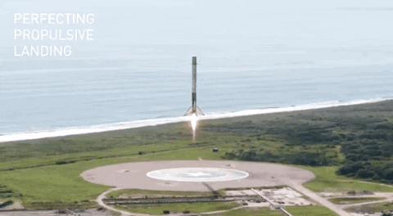






SpaceX Rocket Recapture Modeling
Jamahl Stokes
2/5/2023

Slide 2



OUTLINE
Executive Summary
Introduction
Methodology
Results
Visualization – Charts
Dashboard
Discussion
Findings & Implications
Conclusion
Appendix

Slide 3

EXECUTIVE SUMMARY
We try to find features that predict the success, or failure, in landing the 1st stage of a Falcon 9 rocket.
Captured relevant data for analysis.
Data collected from SpaceX API and Wikipedia.
Used SQL and Visualization to explore data.
Plotted geographic data to garner additional insight.
Built dashboard to explore data granularly.
Developed predictive models that accurately predict SpaceX Falcon 9 rocket landing failures, and (with less accuracy) successes.

Slide 4

INTRODUCTION
We will use past data to predict whether the Falcon 9 rocket will land successfully.
The Falcon 9 rocket has a stage that can be reused, upon successful landing.
Reusing rocket parts allows for significant savings, a competitive advantage in the aeronautics industry.
What factors are important to the successful recapture of stage 1 of a rocket?
Can these factors be used to successfully predict the success of rocket launches?

Slide 5

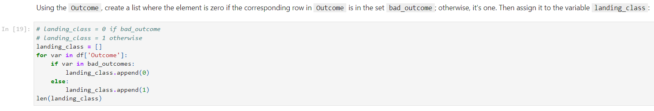
METHODOLOGY (Data Wrangling)
Retrieved and parsed data from SpaceX API.
Addressed gaps in data using data imputation.
Scraped and parsed additional launch data from Wikipedia.
Labeled target categorical data.

Slide 6
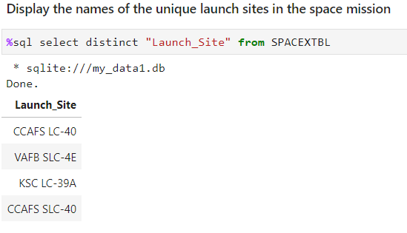
METHODOLOGY (EDA w/ SQL & Visuals)
Developed SQL queries to explore data further.
Used feature engineering to convert categorical features to numeric values.
Displayed geographic data to identify insights not easily captured from tabular analyses.

Slide 7
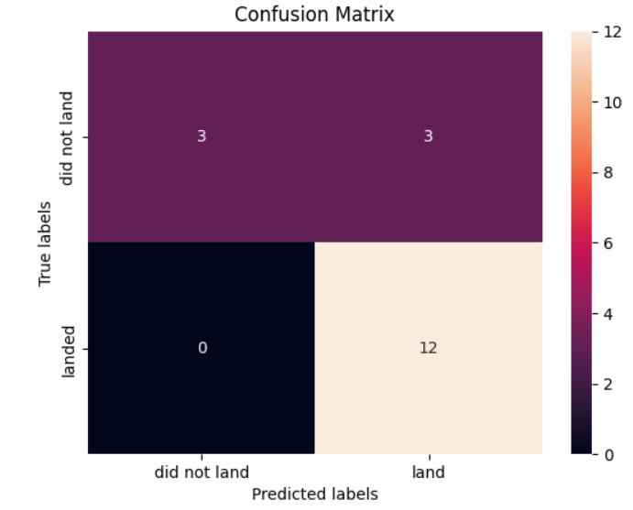
METHODOLOGY (Predictive Analysis)
Standardized numeric values for consistency.
Transformed data into format for model input.
Split data into training and test sets.
Used GridSearchCV to identify parameters that improve model performance.
Compared logistic regression, support vector machine, decision tree classifier, and k-nearest neighbors.
Calculated accuracy scores (R2) and plotted confusion matrices.

Slide 8

RESULTS

Slide 9
EDA WITH SQL - FINDINGS & IMPLICATIONS
Findings
4 launch sites, though some are similarly named
Calculated average mass of payload carried by booster
Calculated number of success and failure outcomes
Implications
Different sites used for different launch types
Payload may be correlated with other features (e.g. orbit)
Variations in data can illuminate impactful features

Slide 10
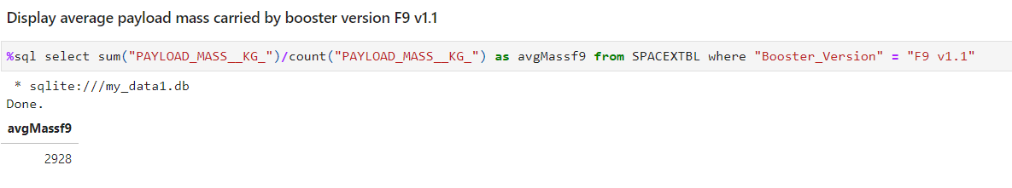
SQL EXPLORATORY DATA ANALYSIS
4 distinct launch sites, with similar naming conventions
Payload mass often differed from the average

Slide 11
EDA WITH VISUALIZATION - FINDINGS & IMPLICATIONS
Findings
Success varied with orbit
Later launches showed greater success
Launch sites varied in the payloads of rockets launched
Implications
Some orbits inherently difficult
Over time, effective improvements were made
Some sites are better suited for launches of large rockets

Slide 12
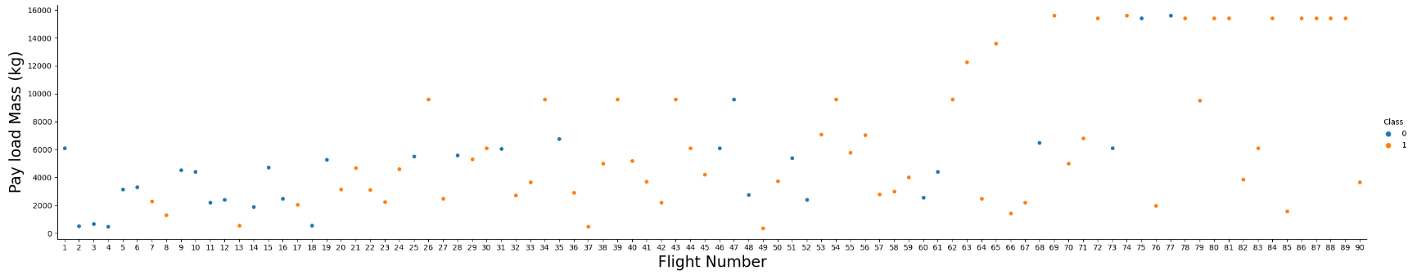
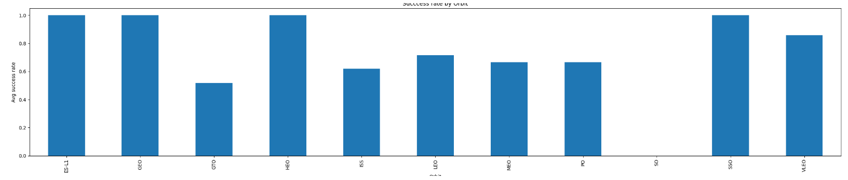
VISUALIZATIONS
Higher success in later flights, with greater payloads
Success rates differ across orbital patterns

Slide 13
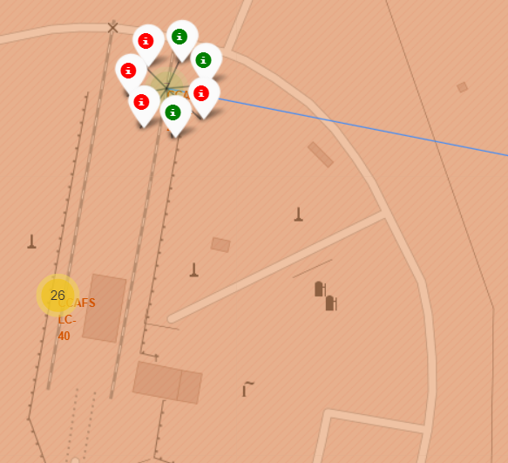
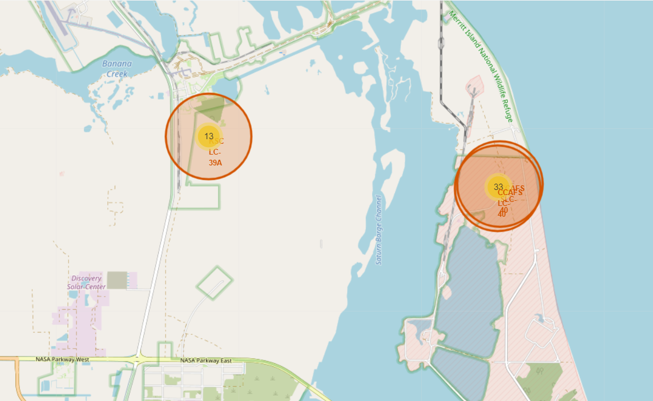
FOLIUM RESULTS
Success rates vary by launch site
Launch sites close to coasts, highways, and rail

Slide 14

DASHBOARD
The dashboard uploaded here was developed to examine the success rates across launch sites and to explore how launch sites varied in the payload mass that rockets caried.
Results showed that payload mass and launch site were correlated with launch and re-landing success.

Slide 15
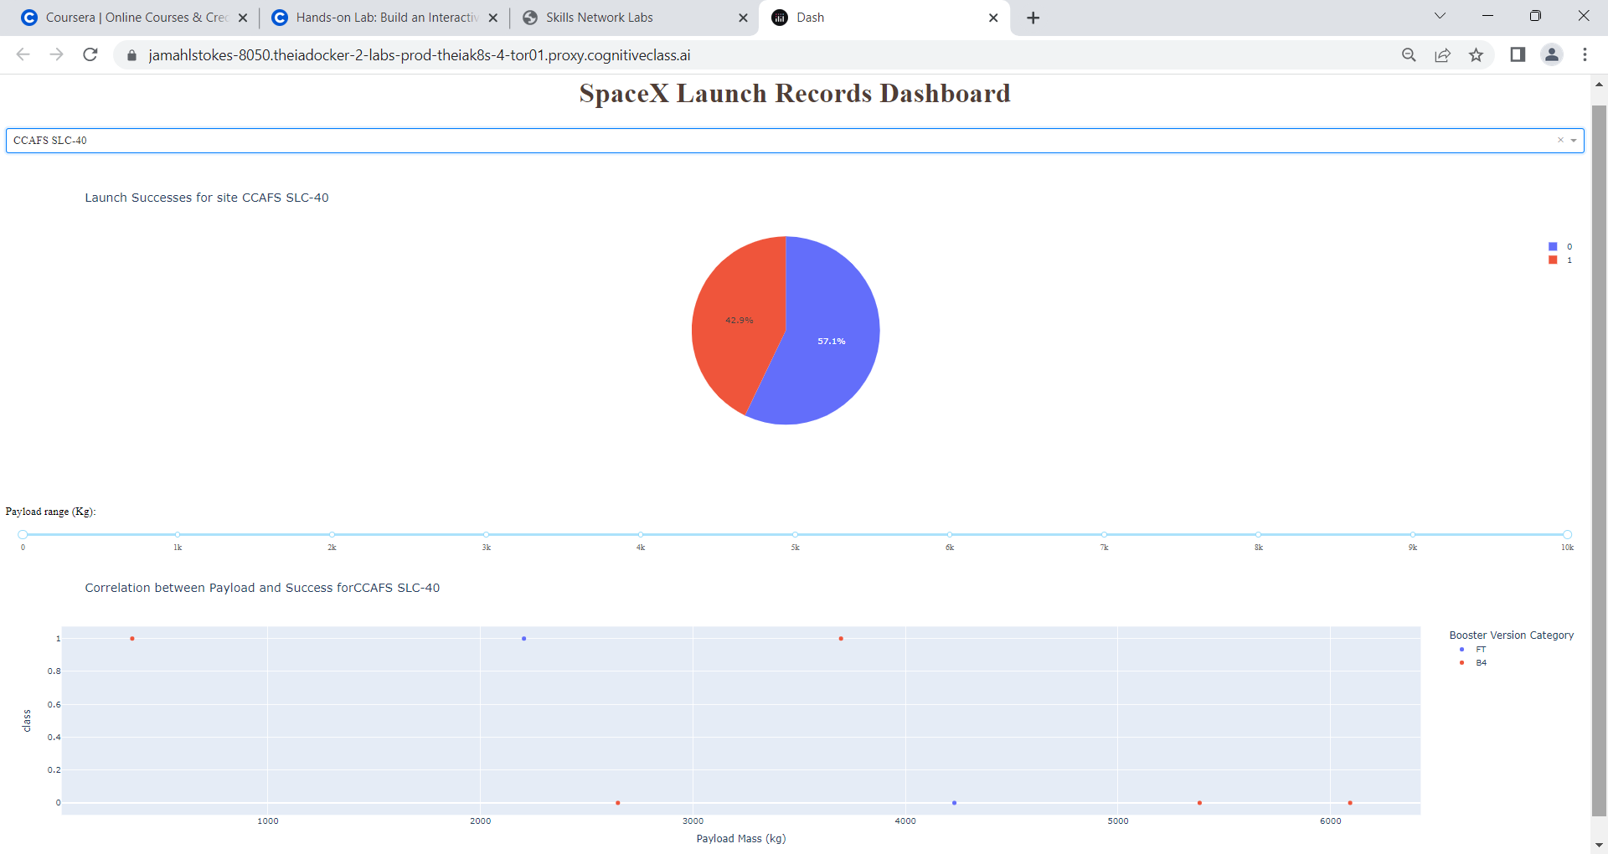
DASHBOARD

Slide 16
PREDICTIVE ANALYSIS
Logistic regression, SVM, and KNN show equivalent performance, beyond that of decision tree classification.

Slide 17
OVERALL FINDINGS & IMPLICATIONS
Findings
Selection of launch sites influences mission success
Predictive models accurately classified failures, with lower scores classifying successes
Implications
Launch sites can be preselected advantageously
Additional data might improve model prediction accuracy

Slide 18

CONCLUSION
Re-capture of stage 1 of rockets saves significant costs.
Factors such as mission orbit, launch site, launch date, and payload impact success rates.
Predictive models, informed by past launches, can be developed to help forecast future launch successes.

Slide 19

APPENDIX

Slide 20
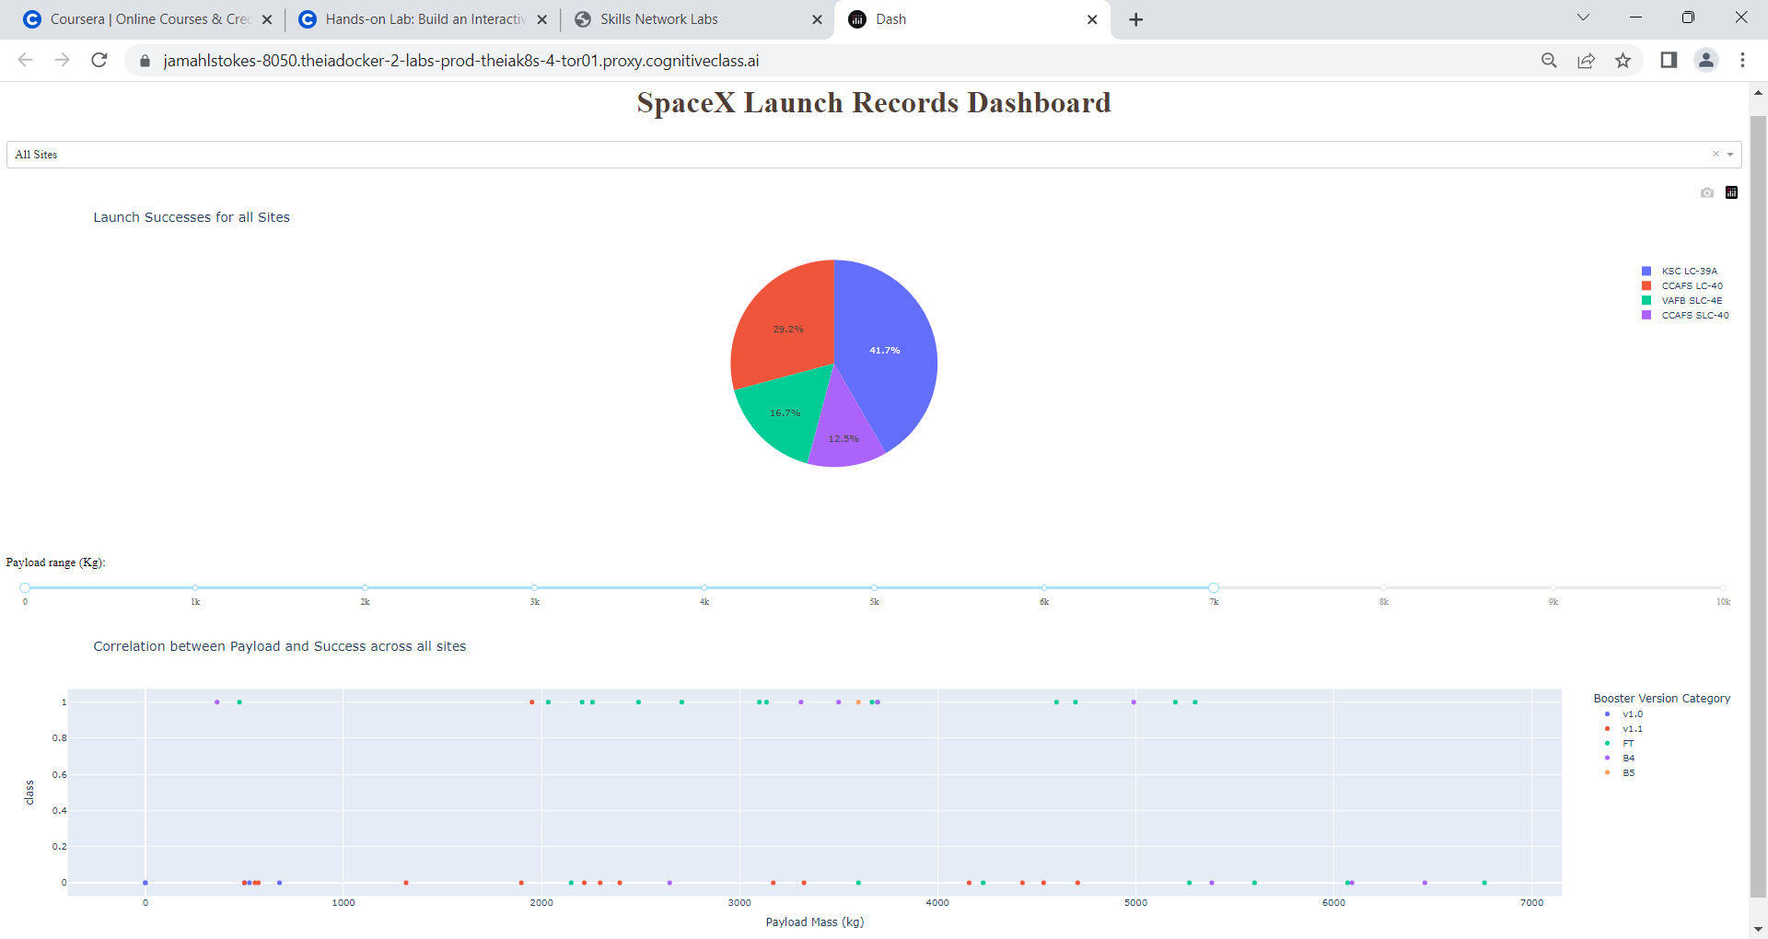
DASHBOARD – Dropdown & Slider

Slide 21
SUPPLEMENTAL FILES
Supporting files for all analyses presented have been uploaded to my personal Github account <https://github.com/jamahlstokes/IBM-DataScience-Public>.
Enjoy!

